Slide 1

Blockchain course ETHEREUM AND SMART CONTRACTS: ENABLING A DECENTRALIZED FUTURE
Dr. Norbert Oláh

Slide 2
Table of Contents
SMART CONTRACTS
ETHEREUM
EVM (ETHEREUM VIRTUAL MACHINE)
USE CASES

Slide 3
SMART CONTRACTS

Slide 4

BITCOIN REVIEW
PROPERTIES OF BITCOIN
… but first, a question:
What makes Bitcoin so special?
Notes:
Bitcoin: Identity, record keeping, transaction and consensus (4 key components)
These 4 main components was what differed Bitcoin from everything else at the time
Mostly, it is a distributed network

Slide 5


A DISTRIBUTED NETWORK
BITCOIN’S BARE BONES
...
...
cryptographic identities
trustless consensus
...
blockchain
Notes:
(Perfect rationale for what makes Bitcoin special!)
Bitcoin’s consensus protocol which allows anyone to join network == makes it significant
Consensus protocol ⇒ Proof of work consensus

Slide 6
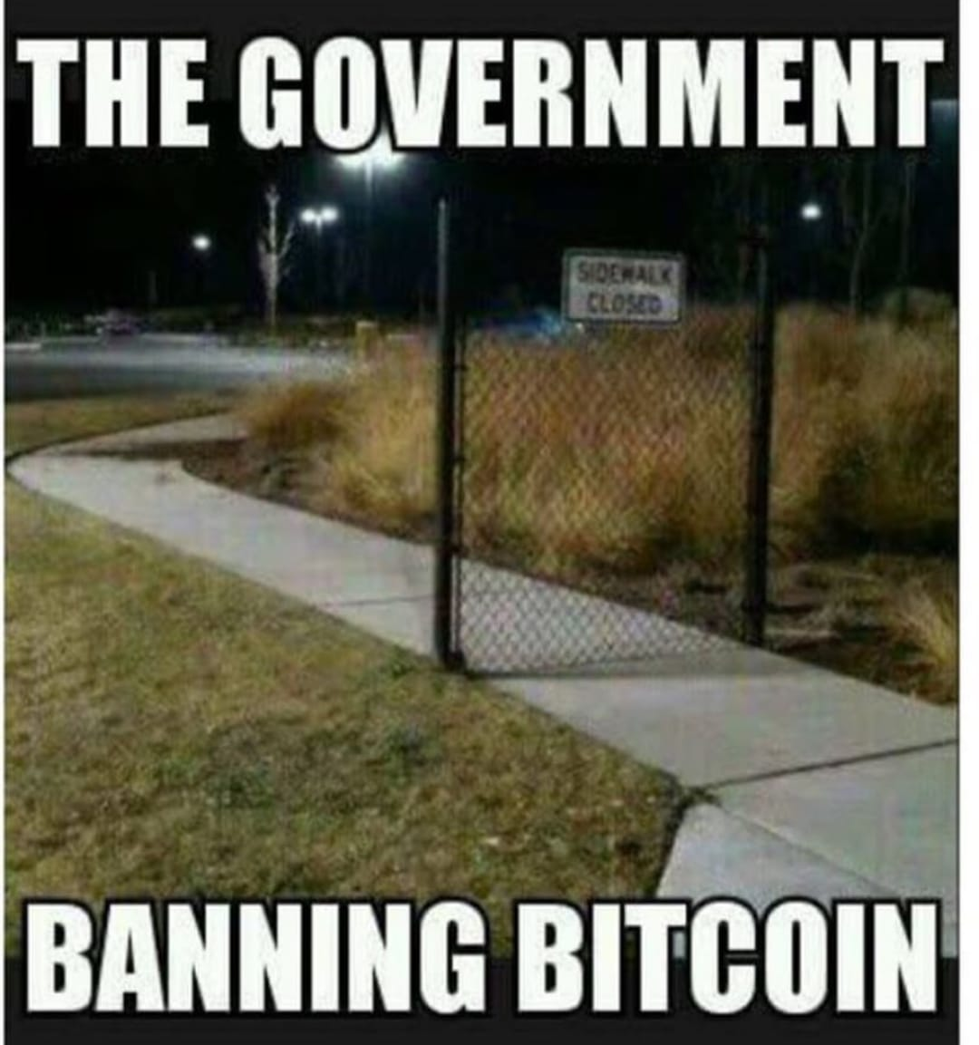
A DISTRIBUTED NETWORK
TRANSFERRABLE BENEFITS OF BITCOIN
Pseudonymous, cryptographic identities allow for accountability
Democratic decisions made through consensus protocol that doesn’t require trust
Immutable ledger of truth
Uncensorable, cannot be controlled by any one party
Distributed: no central point of failure
Notes:
1. Pseudonymous:
When we talked about Bitcoin = emphasized the importance of identity: especially in order to enable authentication + integrity
Cryptographic identities allow for accountability = gives everyone a unique identity through a hash
This generates a private key + public facing address (a public key(
2. Democratic
Decisions made through a consensus protocol
don’t require you to trust anybody else on the network
You just need to trust the math behind the consensus
3. Immutable
Everyone see the same version of truth since we have consensus
Also have tamper evident data structures so that no one can change the history (we can easily see if it has been changed by using the Merkle Tree and comparing the hashes)
4. Uncensorable
To censor transactions, need to control a large proportion of the network. It cannot be controlled by any one party.
5. Distributed
No central point of failure
Executation of tx. depends on a network of miners located around the world
Let’s keep Bitcoin’s architecture in mind as we talk about Smart Contracts + Ethereum

Slide 7
SMART CONTRACTS
CONTRACTS
con·tract
(noun) /ˈkäntrakt/
1. a written or spoken agreement ... that is intended to be enforceable by law.
Notes:
Notice: contract must be agreed upon + enforced by law
Thus, need a consensus protocol
Through a consensus, we should be able to agree on both the contents of the contract + execution of the contract.
what makes a smart contract...smart?

Slide 8

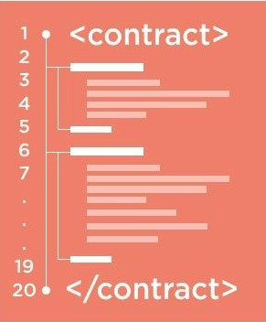
SMART CONTRACTS
CONTRACTS
smart con·tract
(noun) /smärt ˈkäntrakt/
1. code that facilitates, verifies, or enforces the negotiation or execution of a digital contract.
Trusted entity must run this code
Notes:
smart contract:
piece of code that facilitates, verifies, or enforces the negotiation or execution of a digital contract
to reach consensus = trusted entity must run this code
we all need to trust that a digital contract is enforced correctly
diff from traditional contract vs smart contract = execution + enforcement is done through algorithms, not through law

Slide 9
ETHEREUM

Slide 10
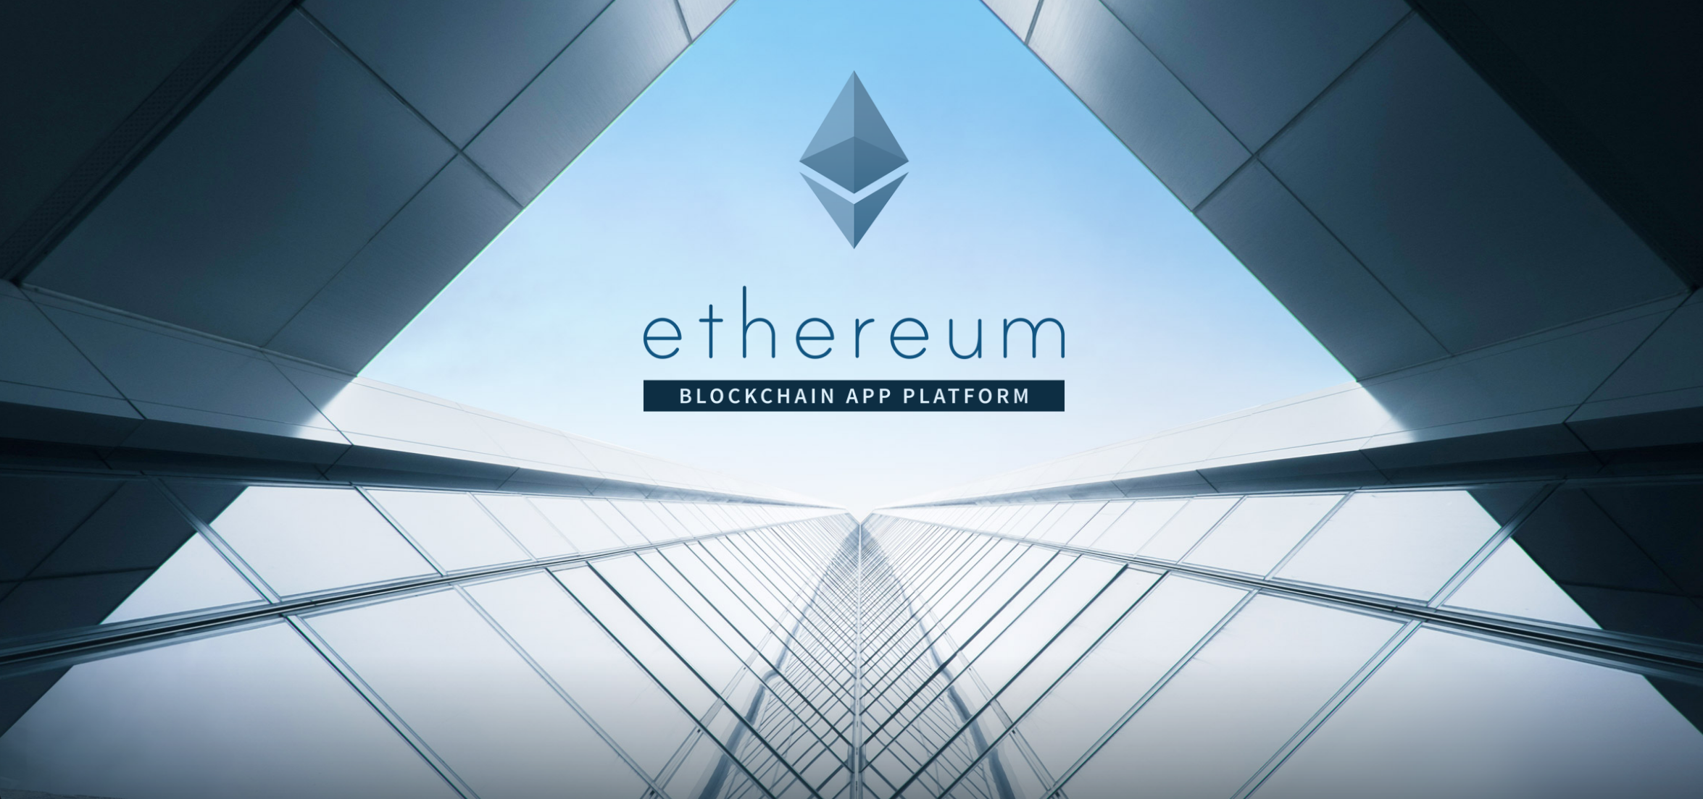
BLOCKCHAIN FUNDAMENTALS LECTURE 5
Notes:
Just like bitcoin, ethereum is a platform that is rapidly changing
Under active development by the Ethereum team + large open source community
A lot of companies + people are using ethereum to build applications + Ethereum continues to adapt by updating and growing

Slide 11
WHAT IS ETHEREUM?
HIGH-LEVEL OVERVIEW
Ethereum is a decentralized platform designed to run smart contracts
Like a distributed computer to execute code
Distributed state machine - transactions change global state
transactions == state transaction function
Ethereum has a native asset called ether
Notes:
On website: “Ethereum is a decentralized platform designed to run smart contracts.”
Basically: distributed computer spread amongst a multitude of nodes across the world that executes code that people feed to it
Because of this architecture: it can run many applications.
Ethereum was formally implemented as a distributed state machine + tx. on the network change the global state of the system
Keeps track of the global system state, which includes: data about who and who owns what
Execution of transactions bring us from a previous state to a new state = state transition functions
Ethereum’s native asset = value in ethereum ecosystem = Ether
Crucial in aligning incentives

Slide 12
WHAT IS ETHEREUM?
HIGH LEVEL OVERVIEW
Look, I found a new block! Check it out and let’s come to consensus!
Nadir
Rustie
Janice
Oscar
Justin
Notes:
5. broadcast to rest of the network (broadcast block header (previous block hash, the merkle root, nonce) = gives you a current block header))
can concatenate the 3 things and hash it to see if it gives the same block header (unique identifier of the block)

Slide 13

WHAT IS ETHEREUM?
HIGH LEVEL OVERVIEW
Nadir
Rustie
Janice
Oscar
What’s in this block?
Justin
Notes:
5. broadcast to rest of the network (broadcast block header (previous block hash, the merkle root, nonce) = gives you a current block header))
can concatenate the 3 things and hash it to see if it gives the same block header (unique identifier of the block)

Slide 14
WHAT IS ETHEREUM?
HIGH LEVEL OVERVIEW
BLOCK HEADER
PREV BLOCK HASH
NONCE
Oh, it’s just a bunch of smart contract code…
I’ll run this code and update my internal state!
TRANSACTIONS
x = 0
y = 0
z = 0
Justin
*This is not exactly how the transactions are stored.
Notes:
5. broadcast to rest of the network (broadcast block header (previous block hash, the merkle root, nonce) = gives you a current block header))
can concatenate the 3 things and hash it to see if it gives the same block header (unique identifier of the block)

Slide 15
WHAT IS ETHEREUM?
HIGH LEVEL OVERVIEW
BLOCK HEADER
PREV BLOCK HASH
NONCE
x = 0
x = 1
y = 0
y = 2
z = 0
z = 3
TRANSACTIONS
x = 1
y = 2
z = 3
Justin
Notes:
5. broadcast to rest of the network (broadcast block header (previous block hash, the merkle root, nonce) = gives you a current block header))
can concatenate the 3 things and hash it to see if it gives the same block header (unique identifier of the block)

Slide 16
WHAT IS ETHEREUM?
Bitcoin
First successful cryptocurrency
Trustless
Immutable
Uncensorable
Pseudonymous
No central point of failure
One-CPU-One-Vote
Notes:
So, like we mentioned a few slides before:
Bitcoin is special because of the following: first successful crypto, trustless…
Ethereum has all of these but has a DIFF use case (next slide)

Slide 17
WHAT IS ETHEREUM?
WHO WOULD WIN?
Notes:
Vitalik Buterin (creator of Ethereum) argued that Bitcoin needed more general purpose scripting language

Slide 18
WHAT IS ETHEREUM?
COMPARISON WITH BITCOIN
Bitcoin
Ethereum
The “Gold Standard” of blockchains
Asset: bitcoins
Primary purpose of the Bitcoin blockchain
Simple and robust
Stack-based, primitive scripting language, not Turing-complete
UTXO-based
Will likely remain Proof-of-Work
Smart Contract Blockchain Platform
Asset: ether
Fund computation
Align incentives
Complex and feature-rich
Turing-complete scripting language
Account-based
Uses Proof-of-Stake
Notes:
Diff btw. Ethereum and Bitcoin
Bitcoin
They are 2 of the most popular blockchain platforms with 2 different goals
Bitcoin: gold standard of blockchains = been around for the longest + had successfully supported many # of tx.
Main purpose: allow tx. of bitcoins
Uses POW
Ethereum
Smart contract blockchain platform, a distributed world computer
Asset: Ether: exist to fund computation + align incentives
Main purpose: not just a global payment system, supports more features (eg: support Turing Complete Scripting Language)
Bitcoin = stack based primitive scripting language = not turing complete = make applications on Bitcoin limited
Etherum uses Turing complete = more applications = developer friendly
Uses blend of PoW and PoS
Turing Complete Scripting:
use for loops + recursive functions, which many verified contracts use

Slide 19
ETHEREUM ACCOUNTS
ACCOUNTS RATIONALE
Bitcoin:
Bob owns private keys to set of UTXOs
Ethereum:
Alice owns private keys to an account
Easy to make transactions and prevent double spending
Space-efficient to update balances instead of storing UTXOs
5 BTC ⇒ Bob
address: “0xfa38b...” balance: 10 ETH code: c := a + b
3 BTC ⇒ Bob
Easier to look up balance and transfer between accounts when programming
2 BTC ⇒ Bob
Notes:
Difference is that bitcoin is UTXO-based whereas Ethereum is account based
Bitcoin
Private keys prove ownership ot UTXO
When you spend Bitcoin, spend from previous tx. + to calculate current balance = have to sum up all UTXO that you own
This makes it easy to make tx + prevent double spending
Ethereum
Private keys prove ownership of account = trakcs a current balance
More space efficient than UTXO as when calculating your own balance = just reference your own account
Stored next to address in the state; only need access to Ethereum wallet
Much cheaper + easier to look up an account balance + transfer btw. accounts when we have an account model

Slide 20
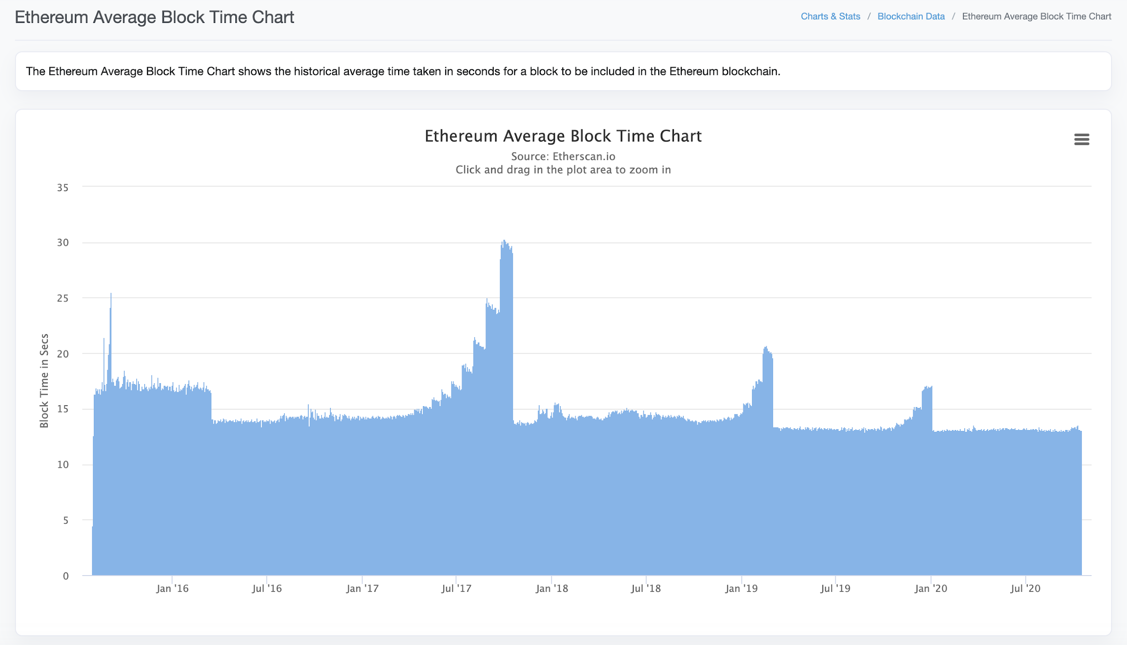
WHAT IS ETHEREUM?
Misc. Implementation Details
Block creation time: ~13 sec (Ethereum) vs ~10 min (Bitcoin)
Proof-of-Work: Ethash (currently ASIC resistant) vs SHA-256
Exchange Rate: $367.75 (2020-10-16)
COMPARISON WITH BITCOIN
Notes:
Update image
Blocktime of Ethereum and Bitcoin: explain why Ethereum is so much faster without losing security

Slide 21

ETHEREUM ACCOUNTS
ACCOUNT TYPES
Externally Owned Accounts
Owned by some external entity (person, corporation, etc.)
Can send transactions to transfer ether or trigger contract code
Contains:
Address
Ether Balance
Contract Accounts
“Owned” by contract
Code execution triggered by transactions or function calls (msg)
Contains:
Address
Associated contract code
Persistent storage
Notes:
2 types of accounts: externally owned + contract
1. Externally Owned
contain an address that they use to let people send them ether + also a balance of ether
owned by external entity + send tx. to transfer ether or trigger contract code
2. Contract Code
owned by smart contracts
contain address associated with contract + persistent storage
code is executed when externally owned accounts / other contract accounts make tx. to trigger their code’s function calls

Slide 22
DISCUSSION QUESTION
DESIGN CHOICES
What are strengths of the UTXO Model?
Select all that apply.
A) Verifying transaction validity and checking double-spending
B) Space efficiency
C) Looking up account balances quickly
D) Ease in programming

Slide 23
DISCUSSION QUESTION
DESIGN CHOICES
What are weaknesses of the UTXO Model?
Select all that apply.
A) Verifying transaction validity and checking double-spending
B) Space efficiency
C) Looking up account balances quickly
D) Ease in programming

Slide 24
DISCUSSION QUESTION
DESIGN CHOICES
What are weaknesses of the UTXO Model?
Select all that apply.
A) Verifying transaction validity and checking double-spending
B) Space efficiency
C) Looking up account balances quickly
D) Ease in programming

Slide 25

ETHEREUM SMART CONTRACTS
CONTROL
Smart Contracts in Ethereum are like autonomous agents that live inside of the Ethereum network
React to external world when "poked" by transactions (which call specific functions)
Have direct control over:
internal ether balance
internal contract state
Message me when you want me to do something!
Notes:
SC are like autonomous agents that live inside of Ethereum network
Reacts to external world when they are poked by tx. which call specific functions
Has direct control over: internal ether balance + internal contract state + permanent storage

Slide 26
ETHEREUM SMART CONTRACTS
SMART CONTRACTS IN ETHEREUM
Ethereum Contracts generally serve four purposes:
Store and maintain data
Data represents something useful to users or other contracts
Ex: a token currency or organization’s membership
Manage contract or relationship between untrusting users
Ex: financial contracts, insurance
Provide functions to other contracts
Serving as a software library
Complex Authentication
Notes:
Ethereum serves 4 main purposes
Store and maintain data
data representing smth useful to users ot other contracts
eg: could be a smart contract defining a new token currency or organization’s membership, which you have to pay a certain amount to obtain
SC can be used to manage a contract or relationship btw. untrusting users
EG: Insurance, financial contracts
Provide additional functionality to other contracts
Write contracts that call other contracts perhaps using them as a software library, leveraging the functionality of an existing contract
Smart Contracts can be used for complex authentication use cases

Slide 27
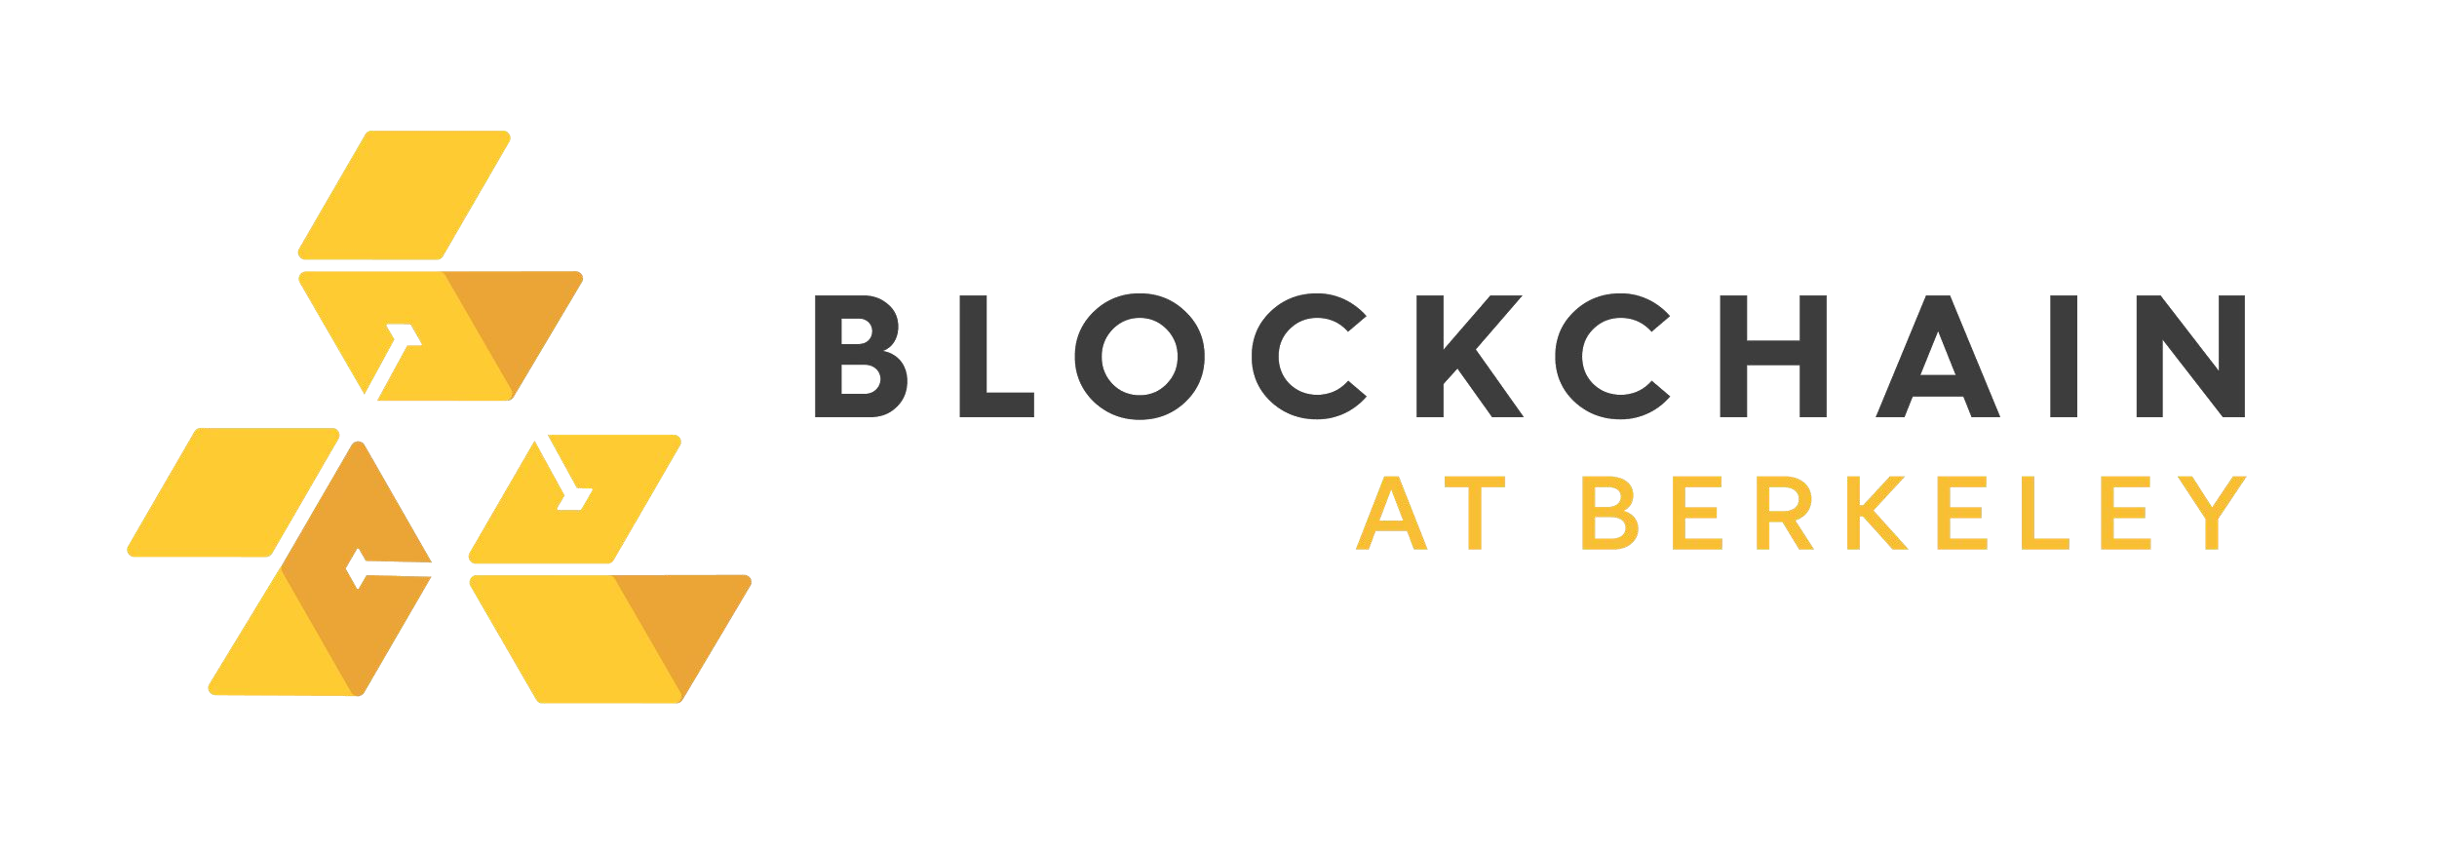
ETHEREUM SMART CONTRACTS
SAMPLE BETTING CONTRACT
contract Betting {
address public owner;
address public gamblerA, gamblerB, oracle;
uint[] outcomes;
struct Bet {
uint outcome; uint amount;
bool initialized;
}
mapping (address => Bet) bets; mapping (address => uint) winnings;
...
/* Defines a Bet */
/* Keep track of every gambler's bet */
/* Keep track of every player's winnings */
function makeBet(uint _outcome) payable returns (bool) { … }
function makeDecision(uint _outcome) oracleOnly() { … }
function withdraw(uint withdrawAmount) returns (uint remainingBal) { … }
AUTHOR: PHILIP HAYES
BLOCKCHAIN FUNDAMENTALS LECTURE 5
}

Slide 28
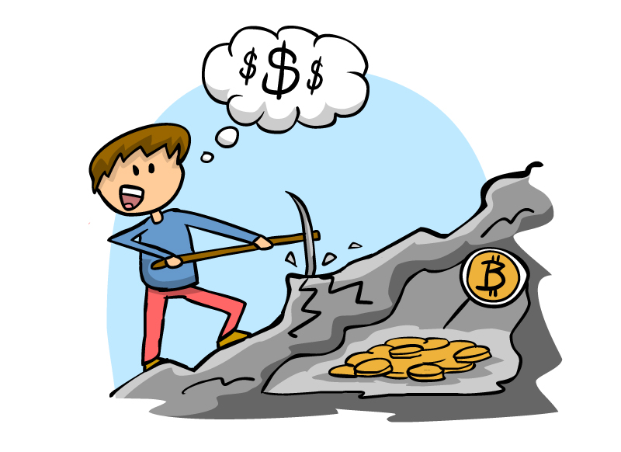
RECIPE FOR MINING: ETHEREUM
SIMILAR TO BITCOIN
A full-fledged Ethereum miner must:
Download the entire Ethereum blockchain
Verify incoming transactions and Run Smart Contract code invoked by transactions
Create a block
Find a valid nonce
Broadcast your block
Profit!
Image source: http://www.coindesk.com/information/how-to-set-up-a-miner/

Slide 29
THE DISTRIBUTED COMPUTER
DISTRIBUTED VERIFICATION & CONSENSUS
Ethereum is a “distributed computer”: every node executes Ethereum smart contracts, then come to consensus on the new network state
Ethereum’s distributed consensus protocol is Proof-of-Stake
Network consensus removes the need for Trusted Third Party
Violation of contracts requires subverting the entire network
Secure Peer-to-Peer agreements that live on the blockchain forever

Slide 30
ETHEREUM VIRTUAL MACHINE

Slide 31
ETHEREUM VIRTUAL MACHINE
COMPILATION AND PROCESS
Solidity Contract
contract B@BCoin {
/* ... */
}
EVM Code
PUSH1 0x60 PUSH1 0x40 MSTORE CALLDATASIZE ISZERO
. . .
PUSH2 0x1b4c POP
JUMP
Solidity Compiler
Vyper Contract
def register(key, value):
/* … */
Vyper Compiler
Notes:
Ethereum SC are generally written in high level programming languages
Most popular = Solidity (mix btw. C++ and JavaScript)
Vyper = newer language
SC written in these languages are compiled down to EVM code
From higher level, human readable language to lower level, simpler language for a machine to easily understand + execute = EVM code

Slide 32


ETHEREUM VIRTUAL MACHINE
HIGH-LEVEL OVERVIEW
The EVM (Ethereum Virtual Machine) is a “mini computer” on your computer that runs contract code
Contract code that actually gets executed on every node is EVM code
EVM code: low-level, stack based bytecode language (i.e. JVM bytecode)
Every Ethereum node runs EVM
Notes:
Miners in Ethereum create blocks by executing EVM code + search for a solution to a mining puzzle
Every Ethereum node runs evm

Slide 33
EVM GAS AND FEES
Immediate Issue:
What if our contract has an infinite loop?
HIGH-LEVEL OVERVIEW
function foo()
{
while (true) {
/* Loop forever! */
}
}
Every node on the network will get stuck executing the loop forever!
By the halting problem, it is impossible to determine ahead of time whether the contract will ever terminate
⇒ Denial of Service Attack!
Notes:
what if there is an infinite loop?
every node = stuck executing the loop forever + by halting problem = it is impossible to determine ahead of time whether the contract will terminate
This leads to an easy way for attackers to launch DENIAL OF SERVICE ATTACKS
Denial of Service attack = trapping computers around the world in an infinite loop = unable to execute other meaningful contracts
SOLUTION: Gas in Ethereum

Slide 34
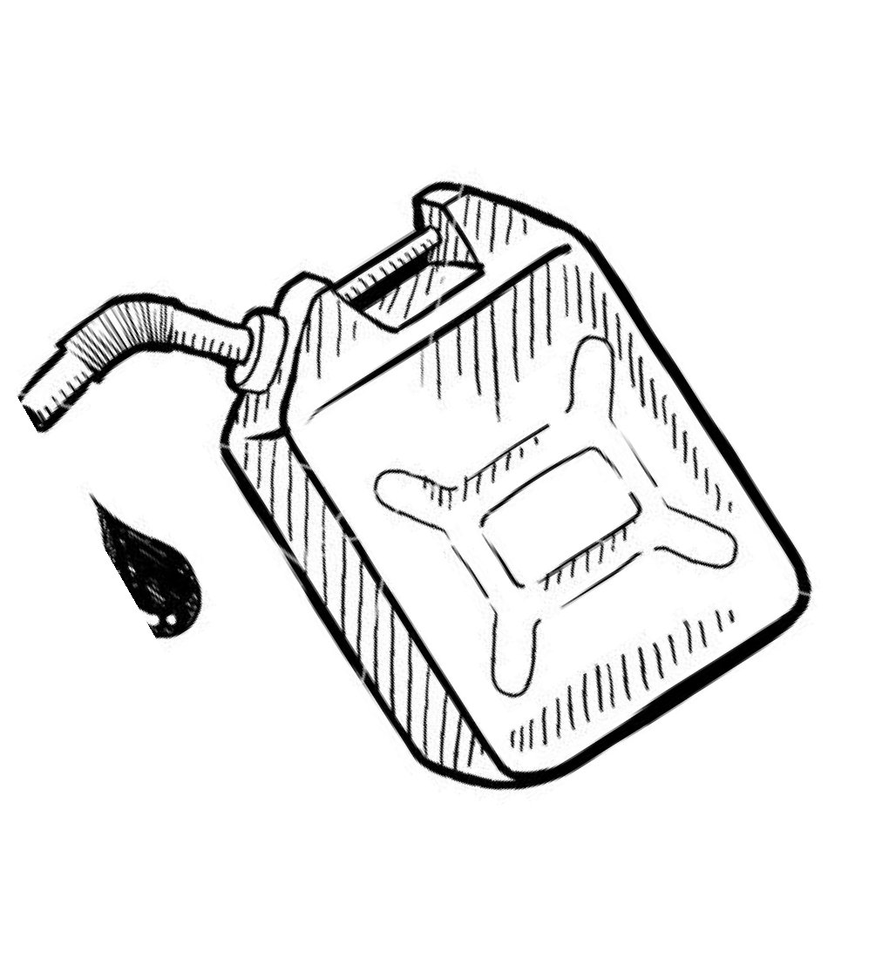

EVM GAS AND FEES
HIGH-LEVEL OVERVIEW
Ethereum’s solution:
Every contract requires “gas”, which “fuels” contract execution
Every EVM op-code requires some gas in order to execute
Every transaction specifies:
the startgas , or the maximum quantity of gas it is willing to consume
the gasprice , or the fee in ether it is willing to pay per unit gas
EVM
Notes:
Gas = fuels the execution of a given contract
every EVM op-code requires gas in order to execute = prevent infinite loop + denial of service attack
Every tx specifies:
startgas = maximum quality of gas it is willing to consume
gasprice = fee in ether the contract is willing to pay per unit gas

Slide 35
EVM GAS AND FEES
HIGH-LEVEL OVERVIEW
At the start of the transaction
startgas * gasprice (units = ether) are subtracted from the sender’s account (the one “poking” the contract)
If the contract successfully executes …
the remaining gas is refunded to the sender
If the contract execution runs out of gas before it finishes …
execution reverts
startgas * gasprice are not refunded
Purchasing gas == purchasing distributed, trustless computational power
An attacker looking to launch a DoS attack will need to supply enough ether to fund the attack
Notes:
start of tx:
stargas * gasprice which represent the amount of Ether paid for a computation = substracted from the sender’s account
sender being the one who invokes the contract by sending tx
If contract = successfully executed
remaining gas is refunded to sender
If contract execution runs out of gas before it finishes:
execution reverts
Ether paid = not refunded
why? although contract execution gets reverted, someone on entwork put computational power to execute EVM code + once gas is spent up, proof that someone executed the program = not refunded
2 end states: program terminates or runs out of gas
Even though Ethereum still allows someone to write an infinite loop:
attacker attempting to DoS the network = pay enough ether to fund the DoS
purchasing gas = price you have to pay to use this distributed computational power
this disincentivez users from running expensive computations w/o having sufficient funds
as it will costattackers a large amount of ether

Slide 36
DISCUSSION QUESTION
UNDERSTANDING THE DISTRIBUTED COMPUTER
Recall that gas is used to pay for your smart contract to be validated by this “distributed computer.” How much gas do you need to supply?
A) Enough for 1 person to run the code
B) Enough for everyone on the network to run the code
C) Enough for the delegated validators to run the code

Slide 37
DISCUSSION QUESTION
UNDERSTANDING THE DISTRIBUTED COMPUTER
Recall that gas is used to pay for your smart contract to be validated by this “distributed computer.” How much gas do you need to supply?
A) Enough for 1 person to run the code
B) Enough for everyone on the network to run the code
C) Enough for the delegated validators to run the code

Slide 38
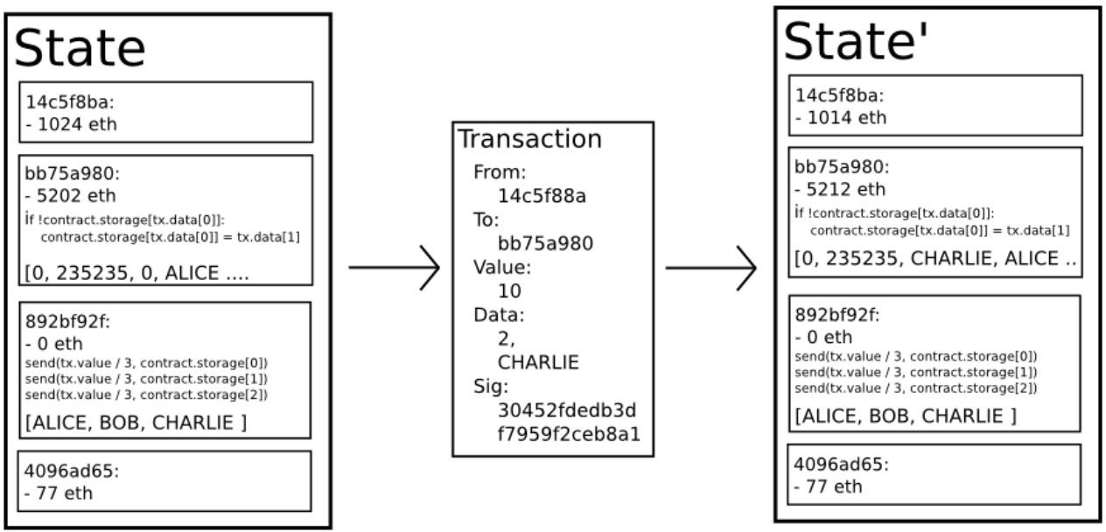
ETHEREUM NETWORK STATE
STATE TRANSITION FUNCTION
(block_state, gas, memory, transaction, message, code, stack, pc)
EVM
(block_state’, gas’)
Ethereum Whitepaper
Notes:
State transition function
When we execute a tx., we go from a prev state to a new state
At the beginning, there was a blank Genesis state, upon which many tx. were executed
At any point in time,
final state represents the current state of the Ethereum
Start: current block state, gas required, current memory, tx. that’s calling a contract, message which contains tx. metadata, code of the contract, stack and program counter
basically everything you need to correctly execute a tx.
feed this into the EVM + get out the new block state with all updated account balances + states + new gas value, which gets refunded

Slide 39
ETHEREUM CONCLUSIONS
IT’S NOT FOR EVERYTHING
Ethereum is not about optimising efficiency of computation
Its parallel processing is redundantly parallel
way to reach consensus on the system state without needing trusted third parties
Contract executions are redundantly replicated across nodes
⇒ expensive, slow, memory-intensive
creates an incentive not to use the blockchain for computation that can be done off chain
Notes:
CONCLUSIONS
Main goal is not to optimize computational efficiency BUT
Enable distributed + trustless computation
Every node on network has to run the same computations = redundantly paralle
This is all to efficiently reach consensus on the system state w/o trusted 3rd parties
Contract executions are redundantly replicated across all nodes, execution is expensive

Slide 40
DISCUSSION
IT’S NOT FOR EVERYTHING
How would you decide between using a centralized and decentralized solution?

Slide 41
Use Blockchain:
Use Centralized Database:
ETHEREUM CONCLUSIONS
IT’S NOT FOR EVERYTHING
Need for a shared database with multiple writers
Parties cannot trust one another, and no trusted third party or authority is available
Interested in fault-tolerance, data immutability or censorship resistance
Database does not need to be shared, or is shared by parties who trust one another
Must keep data confidential
Must handle complex and/or large amounts of data
Need to be able to edit data
Interested in cost-effectiveness, speed or efficiency

Slide 42
USE CASES

Slide 43
4.1
BASIC
USE CASES
Notes:
Decentralized app platform, big platform for handling functionality
One can plug in own basic logic to make whatever they want to happen

Slide 44
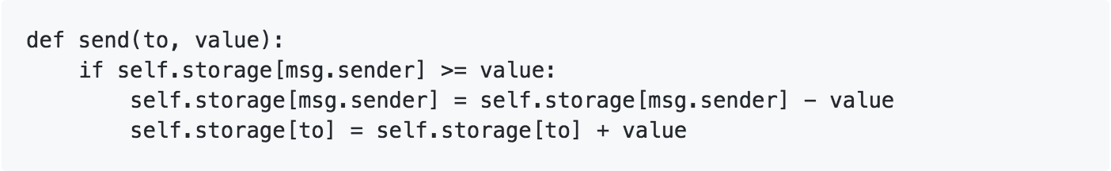
BASIC USE CASES
SMART ASSETS
Token System Implementation
Recreating Bitcoin in 4 lines of code
Database with one operation
Ensure Alice has enough $$ and that she initiated the transaction
Subtract X from Alice, give X to Bob
Notes:
Can code Bitcoin in literally 4 lines; this example is from the Ethereum white paper

Slide 45
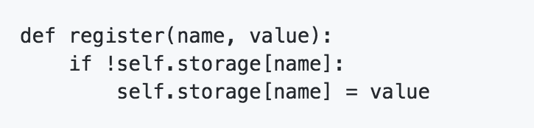
BASIC USE CASES
PUBLIC REGISTRY (ex: Namecoin)
DNS System
Maps domain name to IP address
“gillian.chu” => “12.34.56.78”
Easy to implement in Ethereum
Notes:
Namecoin was the first fork of Bitcoin. The first to implement something called merge mining and a decentralized DNS.
Securely record and transfer arbitrary names (keys)
Attach a value (data) to the names
Transact digital currency namecoins

Slide 46
BASIC USE CASES
DOCUMENT OWNERSHIP
“Proof-of-Existence”
Proves ownership of a certain document without revealing it
Timestamps verify ownership later
Use Cases (simplified):
Rent server space to store documents
Proof document is unmodified via hash values
Integrity guaranteed
Notes:
Since a hash of the document is stored on the Ethereum blockchain, we can verify the integrity
User asks you to hash the document with a certain random number of their choice. If your hash value matches theirs, convinced!

Slide 47
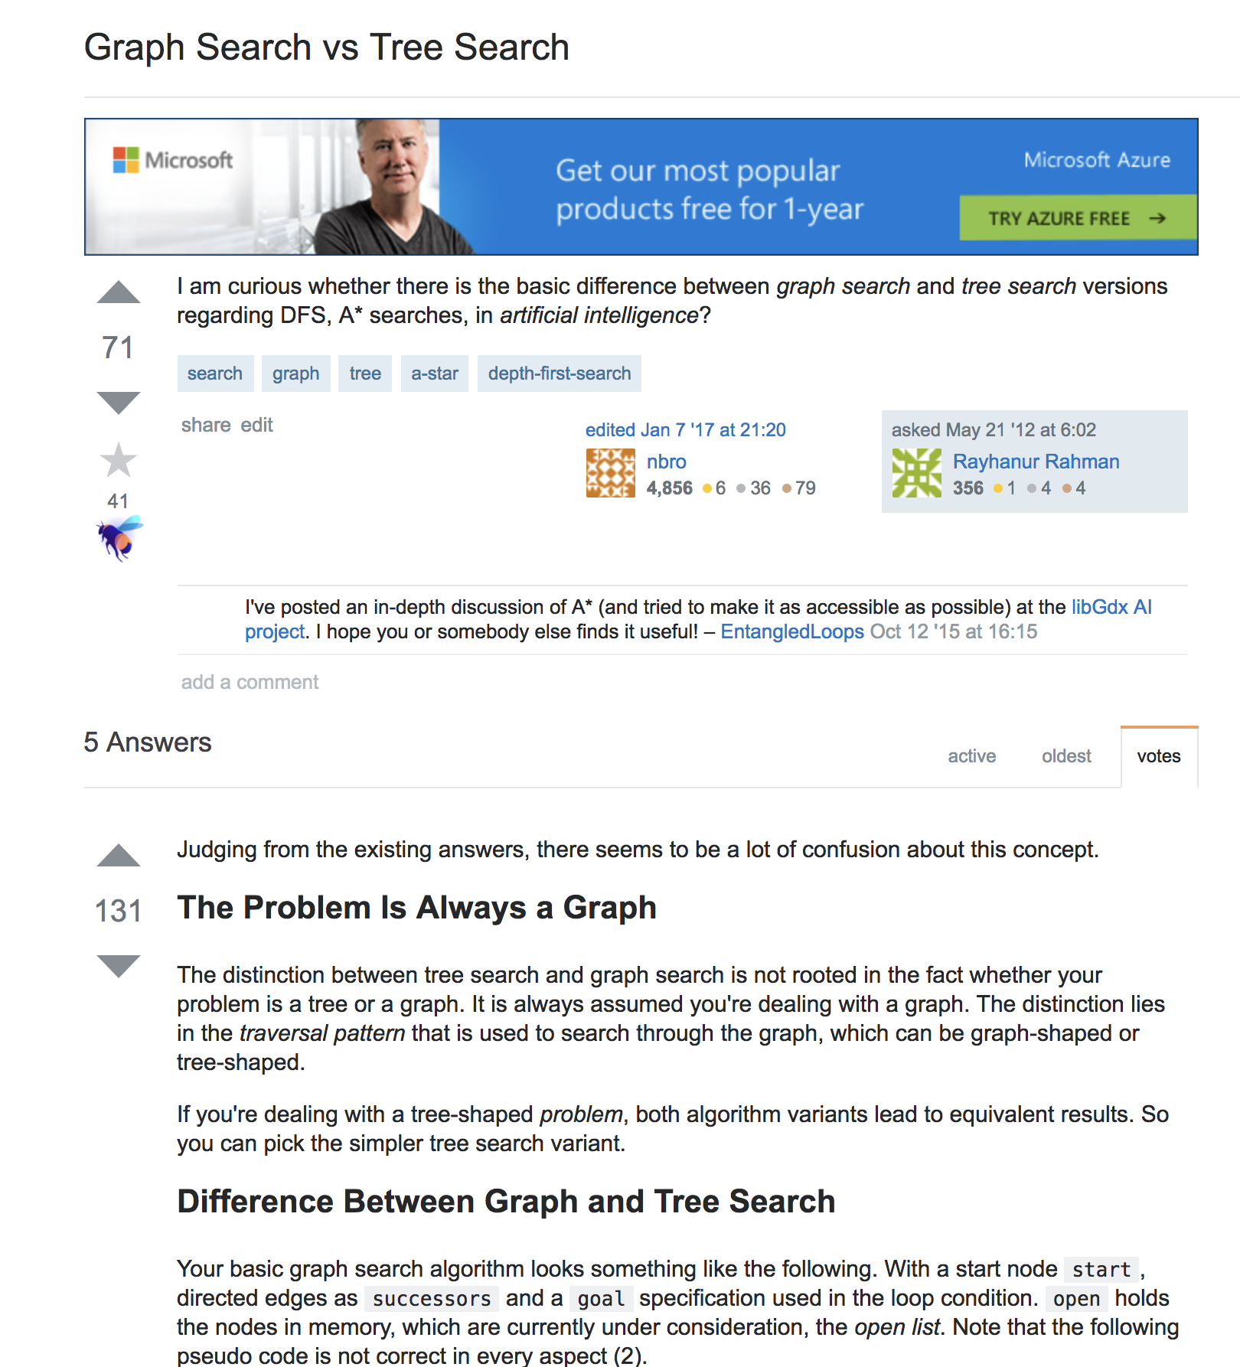
BASIC USE CASES
STANDARD BOUNTIES
ETHDenver
Incentivize answers to StackOverflow Q’s
Makes use of StandardBounties contract
Uses Metamask Integration
Notes:
Brian and Gillian and Tammy went to ETHDenver last weekend
Built a google chrome extension to interface with the blockchain

Slide 48
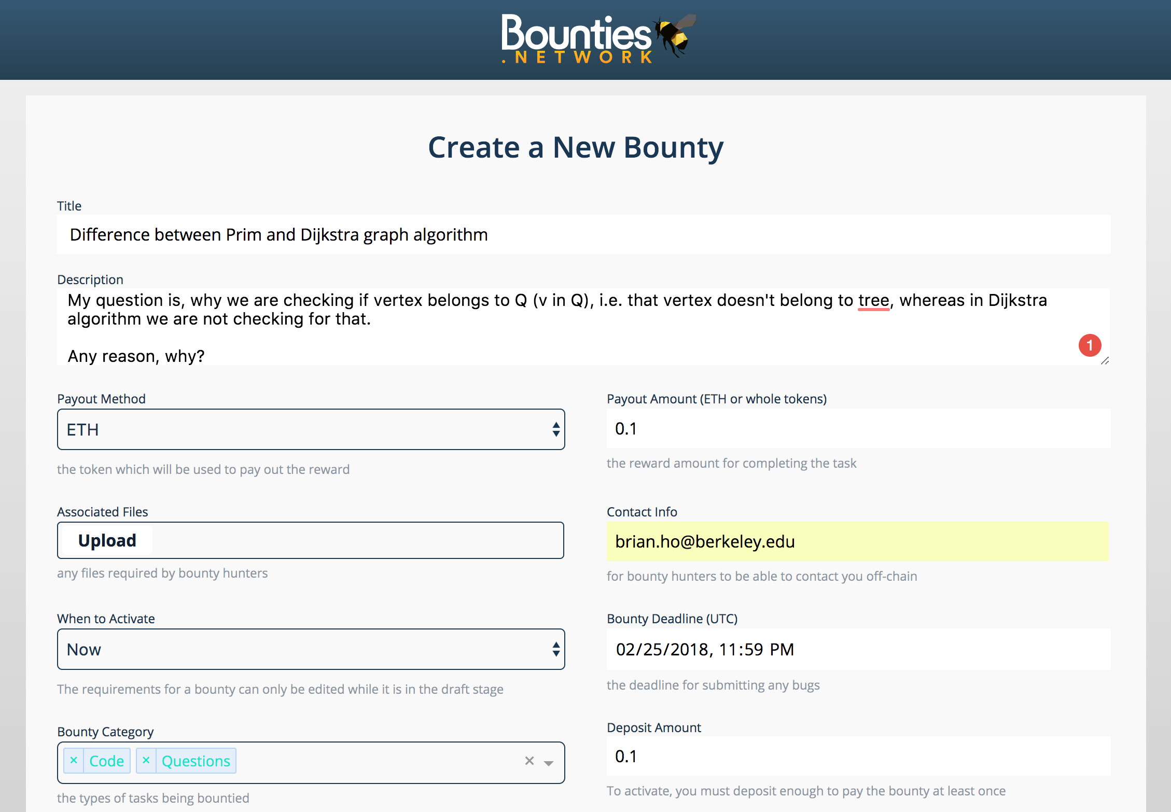
BASIC USE CASES
STANDARD BOUNTIES
ETHDenver
Incentivize answers to StackOverflow Q’s
Makes use of StandardBounties contract
Uses Metamask Integration
Notes:
Brian and Gillian and Tammy went to ETHDenver last weekend
Built a google chrome extension to interface with the blockchain

Slide 49
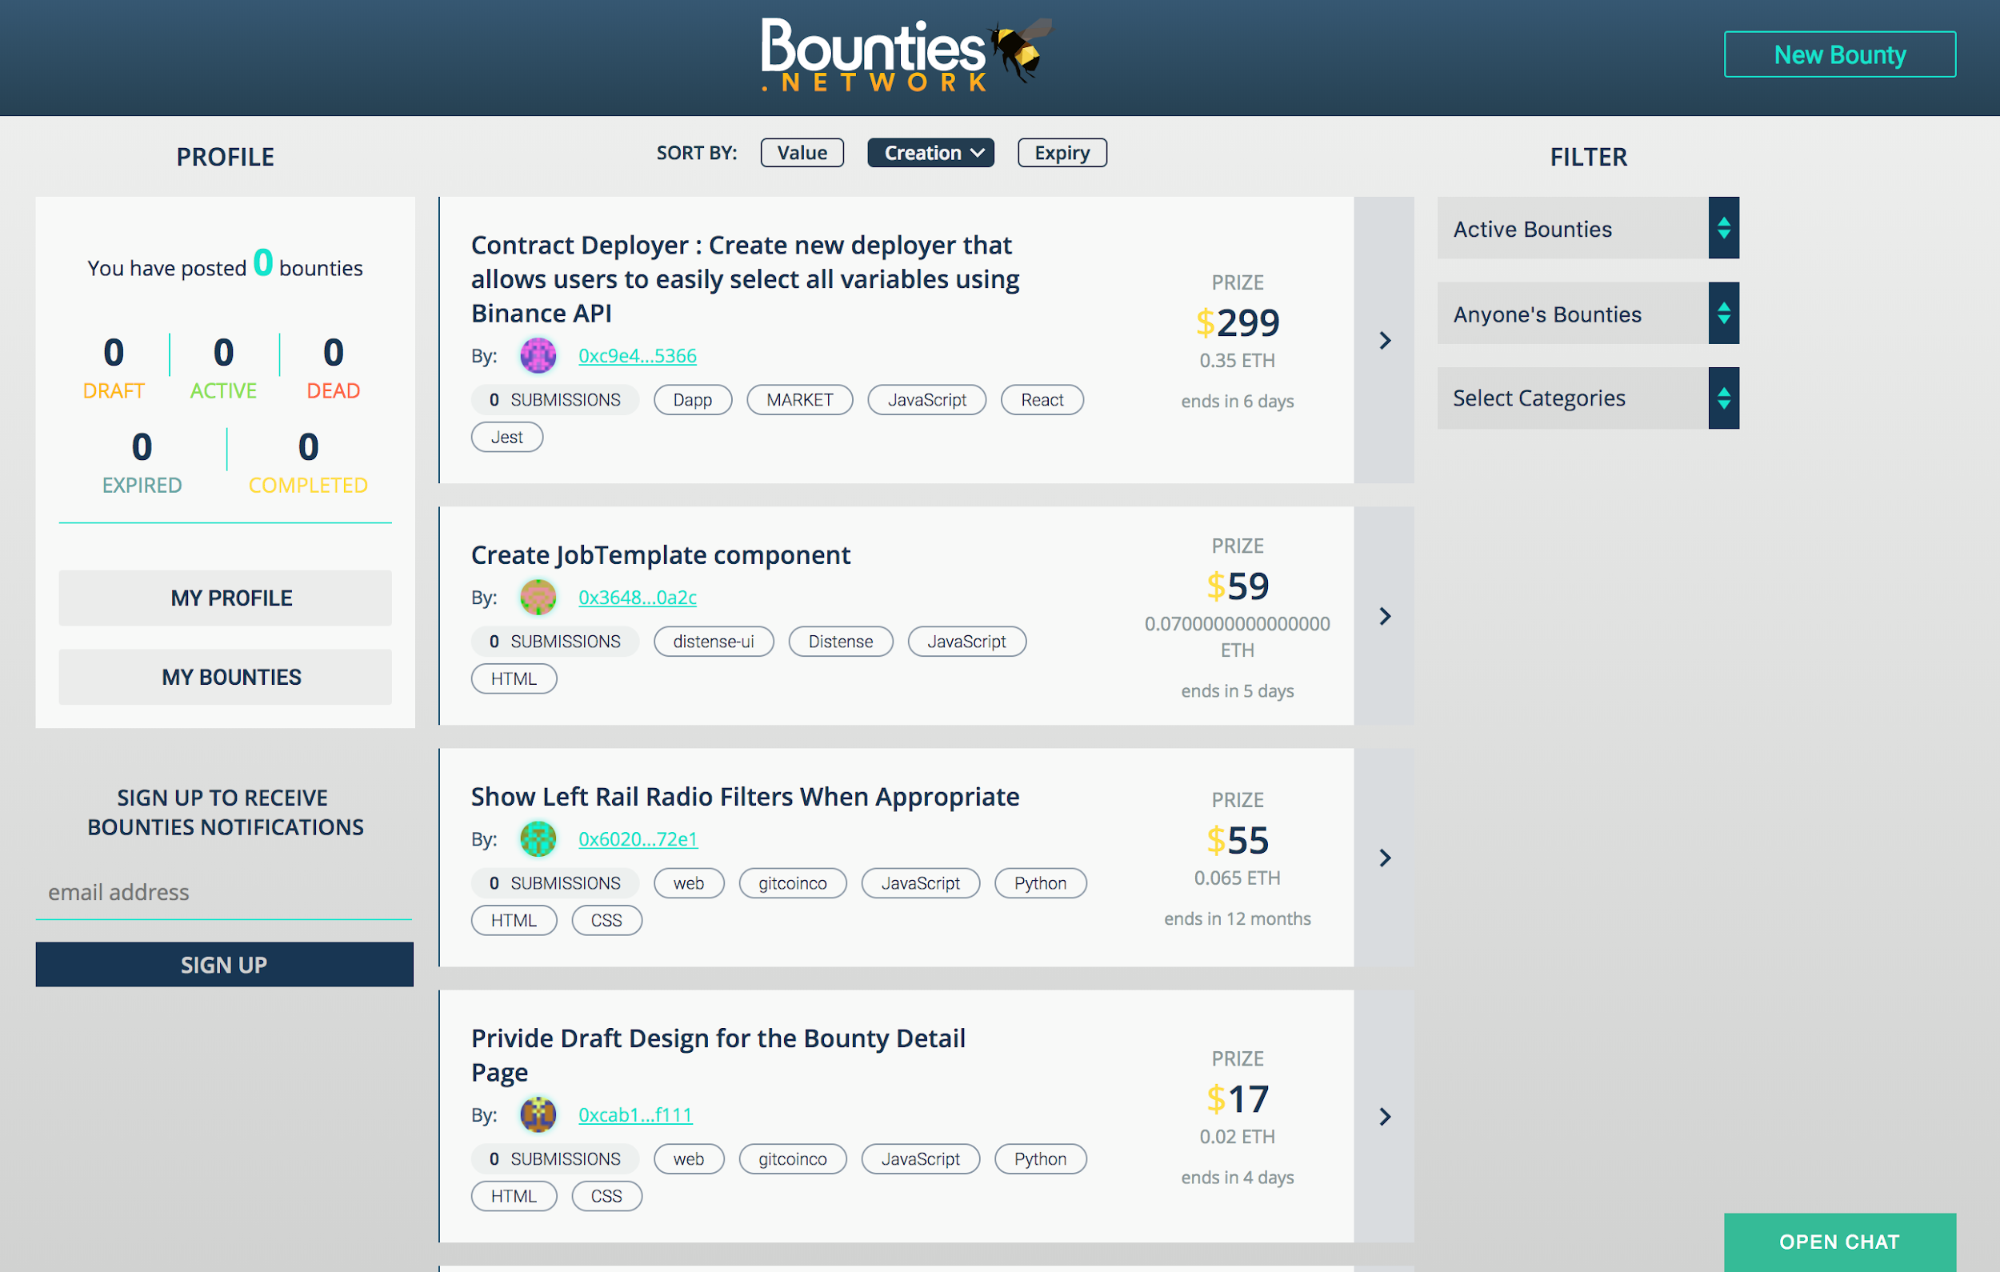
BASIC USE CASES
STANDARD BOUNTIES
ETHDenver
Incentivize answers to StackOverflow Q’s
Makes use of StandardBounties contract
Uses Metamask Integration
Notes:
Brian and Gillian and Tammy went to ETHDenver last weekend
Built a google chrome extension to interface with the blockchain

Slide 50
4.2
ADVANCED USE CASES
Notes:
Decentralized app platform, big platform for handling functionality
One can plug in own basic logic to make whatever they want to happen
To give a brief example of a more advanced use case, one that has been proposed on the government level is the following:

Slide 51

DECENTRALIZED LAND TITLES
Problem:
Flawed paperwork, forged signatures, unclear documents
Lacking central government authority
Pitfalls:
Corrupt officials accepting bribes, tampering with records
Government cannot support land record authority
Citizens mistrustful of NGO/multiple NGOs
Notes:
Hard to trace ownership of land
Blockchain is just a database, it can’t change the way information moves between the real and digital world.

Slide 52

DECENTRALIZED LAND TITLES
The Blockchain Solution:
Hashes & Digital Signatures
Transparency
Immutability
Limits Centralization
Simple mechanism to transfer ownership, like making a transaction on Bitcoin
Notes:
Use hashes and digital signatures to store land titles on public blockchain
Transparency of blockchain prevents confusion and fradulent claims
Immutability prevents forgery of signatures, corrupt information overwrites
No need for government offices: third party intervention for conflict is minimal

Slide 53



DECENTRALIZED LAND TITLES
Caveat:
The blockchain is only as good as the information fed into it.
Countries investigating: Georgia, Ukraine, Sweden
Notes:
Need to trust that the information fed into the blockchain is correct
Tricky to associate virtual identities with land

Slide 54

PREDICTION MARKETS
A QUICK DEFINITION
Draws on the wisdom of the crowd
Ex: “Who will win the 2020 Presidential Election? Zuckerberg or Trump?”
Replace shares with bets
Random oracles report
Centralized Prediction Market
Notes:
We’ll begin with a brief definition of what a prediction market is…
Market makers create an event such as….
Events must be public and easily verifiable, with set due date
Participants buy bets on Trump or Zuckerberg and pay a small fee
The bet price accurately represents the best predicted chance of an outcome occurring
i.e. More expensive if it’s more likely, less expensive if less likely
On election day, random oracles (sensors on the network), will report back on who won
Oracles who voted with the majority collect a fee,
Shareholders who voted correctly cash out on their bet (resolve to $1 if true, $0 if false)
Insider information => arbitrage opportunity (making money by buying and selling in order to take advantage of the different prices for the same asset)

Slide 55


PREDICTION MARKETS
AND DECENTRALIZING THEM….
“A service that never crashes, a service that’s completely transparent…”
Benefits:
no restrictions on market creation
shared liquidity pool
censorship-resistant
automatic, trustless payments
Notes:
Given what we’ve learned, think about how prediction markets can benefit from being decentralized. NOTE: according to the Commodity Futures Trading Commission, this is illegal in the United States.
Benefits to being decentralized:
CAVEAT
need a defense against unethical/illegal markets
Augur has Oracles vote on “unethical” or “undecidable”
No reason why the same market should exist in multiple countries
advanced, combinatorial prediction markets
makes use of the global nature of the blockchain
All of the properties we understood about the blockchain carry into these prediction markets: global, transparency, verifiability, immutability.

Slide 56
PREDICTION MARKETS
AND DECENTRALIZING THEM….
Use Case 1:
Cost-effective way to “buy” information
Bet for/against to incentivize those with insider information
Notes:
So when we’re thinking about use cases for prediction markets, we need to pose a question:

Slide 57
PREDICTION MARKETS
AND DECENTRALIZING THEM….
Use Case 1:
Cost-effective way to “buy” information
Bet for/against to incentivize those with insider information
Will this movie be a flop?
Notes:
Incentivize those with insider information, i.e. the Hollywood insiders, to give you the right answer

Slide 58
PREDICTION MARKETS
OTHER USE CASES
Hedging & Insurance
“Will my house burn down?”
Security Bug Bounty
“If my company is hacked, will the hacker reveal the vulnerability in a whitehat manner?”
ICO Signaling
“Will my ICO deliver products on time?”
Notes:
Hedging & Insurance:
Imagine fire insurance as a bet that your house will burn down. If you create a market for “Will my house burn down?” and you vote yes, you receive compensation if your house burns down. No central intermediary is required, so it’s a cheaper margin!
Security Bug Bounty:
Bet heavily against it to create a financial incentive
Someone who finds vulnerability will bet that the company will get hacked, then perform their hack => get paid
Augur secures their own code this way: “Will someone be able to steal the money in this prediction market?”
Signalling: “Put your money where your mouth is”
Demonstrate commitment-> large financial loss if you miss your commitment
Bet heavily that your product WILL launch on time.

Slide 59
PREDICTION MARKETS
OTHER USE CASES
Also…
“I bet $1 million that Bob will be alive on October 4.”
Assassination Market
Notes:
Hedging & Insurance:
Imagine fire insurance as a bet that your house will burn down. If you create a market for “Will my house burn down?” and you vote yes, you receive compensation if your house burns down. No central intermediary is required, so it’s a cheaper margin!
Security Bug Bounty:
Bet heavily against it to create a financial incentive
Someone who finds vulnerability will bet that the company will get hacked, then perform their hack => get paid
Augur secures their own code this way: “Will someone be able to steal the money in this prediction market?”
Signalling: “Put your money where your mouth is”
Demonstrate commitment-> large financial loss if you miss your commitment
Bet heavily that your product WILL launch on time.

Slide 60
SUPPLY CHAIN AND PROVENANCE
BLOCKCHAIN FUNDAMENTALS
The idea: track supply chain information through a blockchain (transparent, immutable ledger)
Businesses: Efficient transactions through smart contracts, easy tracking and recalls
Consumers: Transparent record of products, applications in fair trade, sustainability, and ethical consumerism
Notes:
Everledger uses a blockchain to prove the origin (provenance) of these diamonds. Global ledger tracks each diamond on the blockchain.
Record a irrefutable digital footprint of the diamond, puts this on the blockchain, tokenizes the diamond
Maintains a complete history of the diamond, where the ledger history is immutable, cryptographically secured, open and transparent
=> well suited for auditing and analysis
Everledger is a decent use case of blockchain for supply chain, but not true for supply chain ideas in general!!
counterfeit goods might be swapped
Hard to prove the token on the blockchain corresponds to the real, physical good
Tamper-evident and hard to forge identifiers into your product? Everledger records the optical fingerprint of each diamond
Cross-validating of information?
but check yourself: remember, that the blockchain is only as good as the data we put into it! Everledger trusts the entities authenticating the diamonds

Slide 61

SUPPLY CHAIN AND PROVENANCE
BLOCKCHAIN FUNDAMENTALS
Problem: Need to trust data input. There is no secure way to bridge the physical and digital worlds.
We could end up with Transparent, Immutable, Integrous... Garbage.
The worst database in the world
~*~blockchain~*~
Notes:
Everledger uses a blockchain to prove the origin (provenance) of these diamonds. Global ledger tracks each diamond on the blockchain.
Record a irrefutable digital footprint of the diamond, puts this on the blockchain, tokenizes the diamond
Maintains a complete history of the diamond, where the ledger history is immutable, cryptographically secured, open and transparent
=> well suited for auditing and analysis
Everledger is a decent use case of blockchain for supply chain, but not true for supply chain ideas in general!!
counterfeit goods might be swapped
Hard to prove the token on the blockchain corresponds to the real, physical good
Tamper-evident and hard to forge identifiers into your product? Everledger records the optical fingerprint of each diamond
Cross-validating of information?
but check yourself: remember, that the blockchain is only as good as the data we put into it! Everledger trusts the entities authenticating the diamonds

Slide 62

SUPPLY CHAIN AND PROVENANCE
BLOCKCHAIN FUNDAMENTALS
Problem: “Blood” diamonds
The Kimberley Process is a governmental effort requiring participants to certify the origin of their diamond.
Corrupt officials take bribes to sign certifications
Complex supply chains mask actual trails
Everledger: provenance of diamonds
Notes:
Everledger uses a blockchain to prove the origin (provenance) of these diamonds. Global ledger tracks each diamond on the blockchain.
Record a irrefutable digital footprint of the diamond, puts this on the blockchain, tokenizes the diamond
Maintains a complete history of the diamond, where the ledger history is immutable, cryptographically secured, open and transparent
=> well suited for auditing and analysis
Everledger is a decent use case of blockchain for supply chain, but not true for supply chain ideas in general!!
counterfeit goods might be swapped
Hard to prove the token on the blockchain corresponds to the real, physical good
Tamper-evident and hard to forge identifiers into your product? Everledger records the optical fingerprint of each diamond
Cross-validating of information?
but check yourself: remember, that the blockchain is only as good as the data we put into it! Everledger trusts the entities authenticating the diamonds

Slide 63
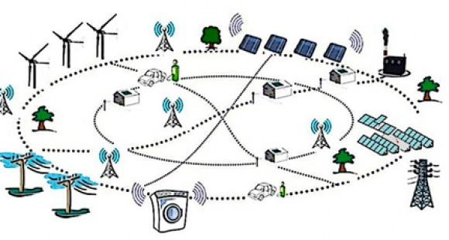
SMART ENERGY GRIDS
BLOCKCHAIN FUNDAMENTALS
Setup: Imbalances in energy across a community of houses
i.e. House A has excess heat,
House C lacks heat
Problem: Need custom infrastructure from A ⇒ B ⇒ C
Solution: Ethereum smart contract for financial commitments
Notes:
Create an energy market where House A sells heat to house C, both parties save money
Problem:
Energy infrastructure currently flows unidirectionally
Utility company doesn’t want to build smart grid, little revenue; government has no incentive
Coordination can’t be found in central entity or government, so households can coordinate to build infrastructure without trusting each other.
Think: i’ll put 5,000 in, and if house B also commits 5,000, the total amount will go to this contractor, and it can only go to this constructor

